Slide 1
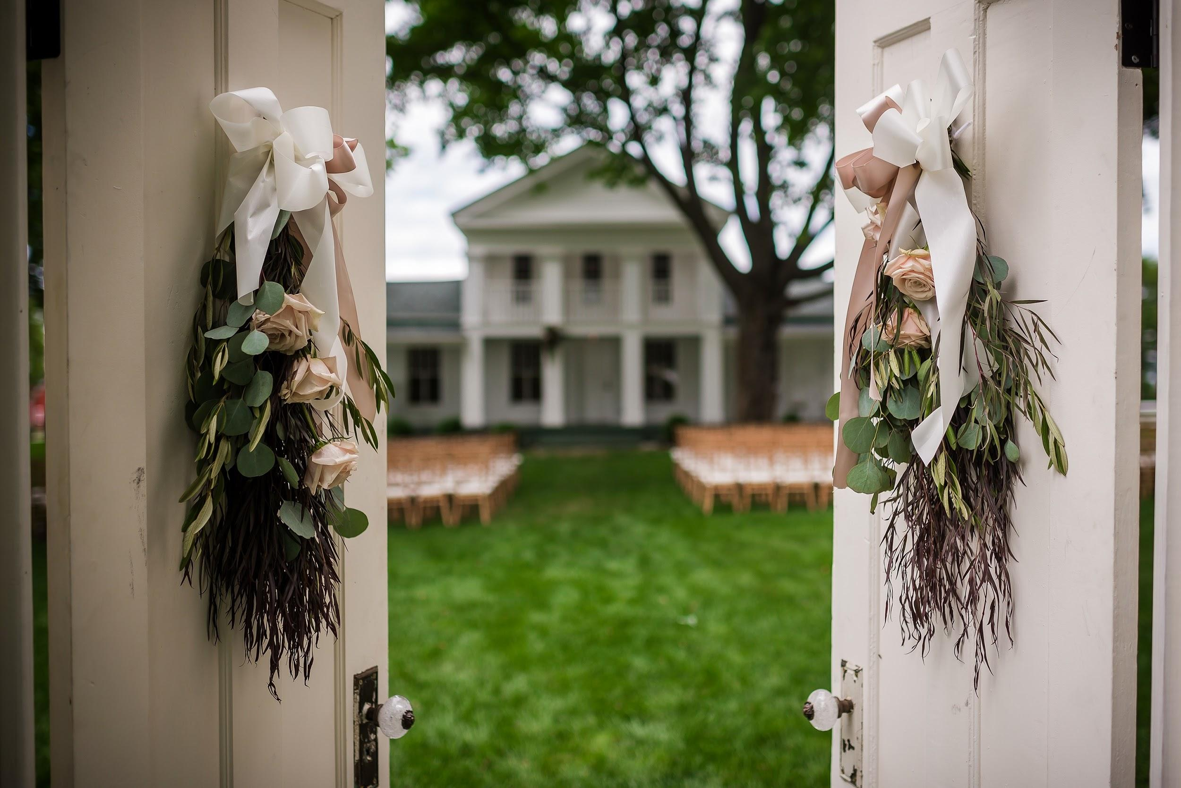
From Conception to Completion
A Presentation by
Jerome Raska AIFD, AAF, PFCI, CAFA, CF

Slide 2
Weddings are a BIG BUSINESS
Approximately 2.3 million couples get married in the U.S. every year
(6,200 weddings a day!)
According to The Knot the average wedding in 2015 was approximately $30,000.
Around $72 billion a year is spent on weddings!
According to The Knot couples spent an average of $2,141 on their wedding florals in 2015.

Slide 3






How to Attract a Client

Slide 4
How Does the Client Contact You?
-Phone Call
-Email
-Fill out a Form on Your Website
-The Knot
-Weddingwire
-Filling out a consultation form in-store or at a bridal show

Slide 5
How Do You Respond?
-Contact the client immediately and set up an in person consultation
Ask some important questions before they come in.

Slide 6
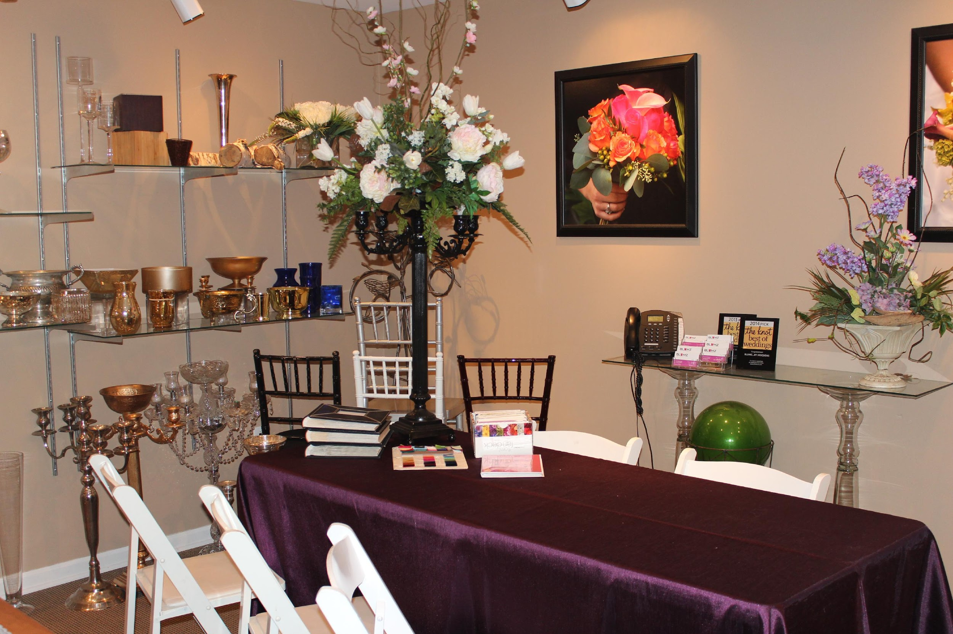
The Consultation

Slide 7
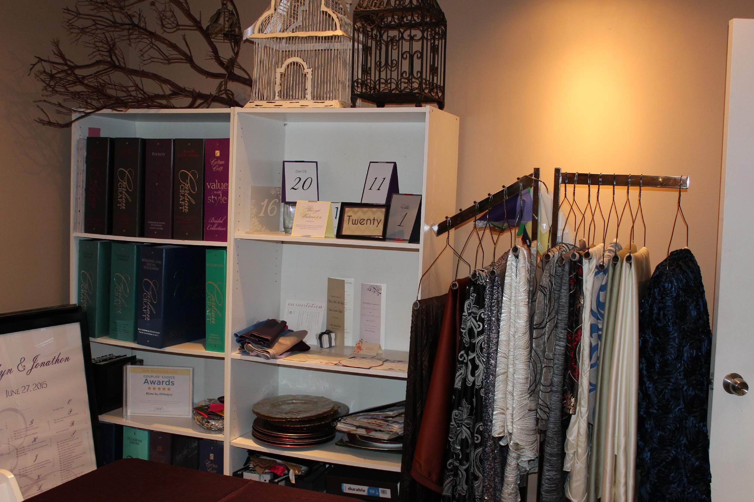
A Proper Consultation Room

Slide 8
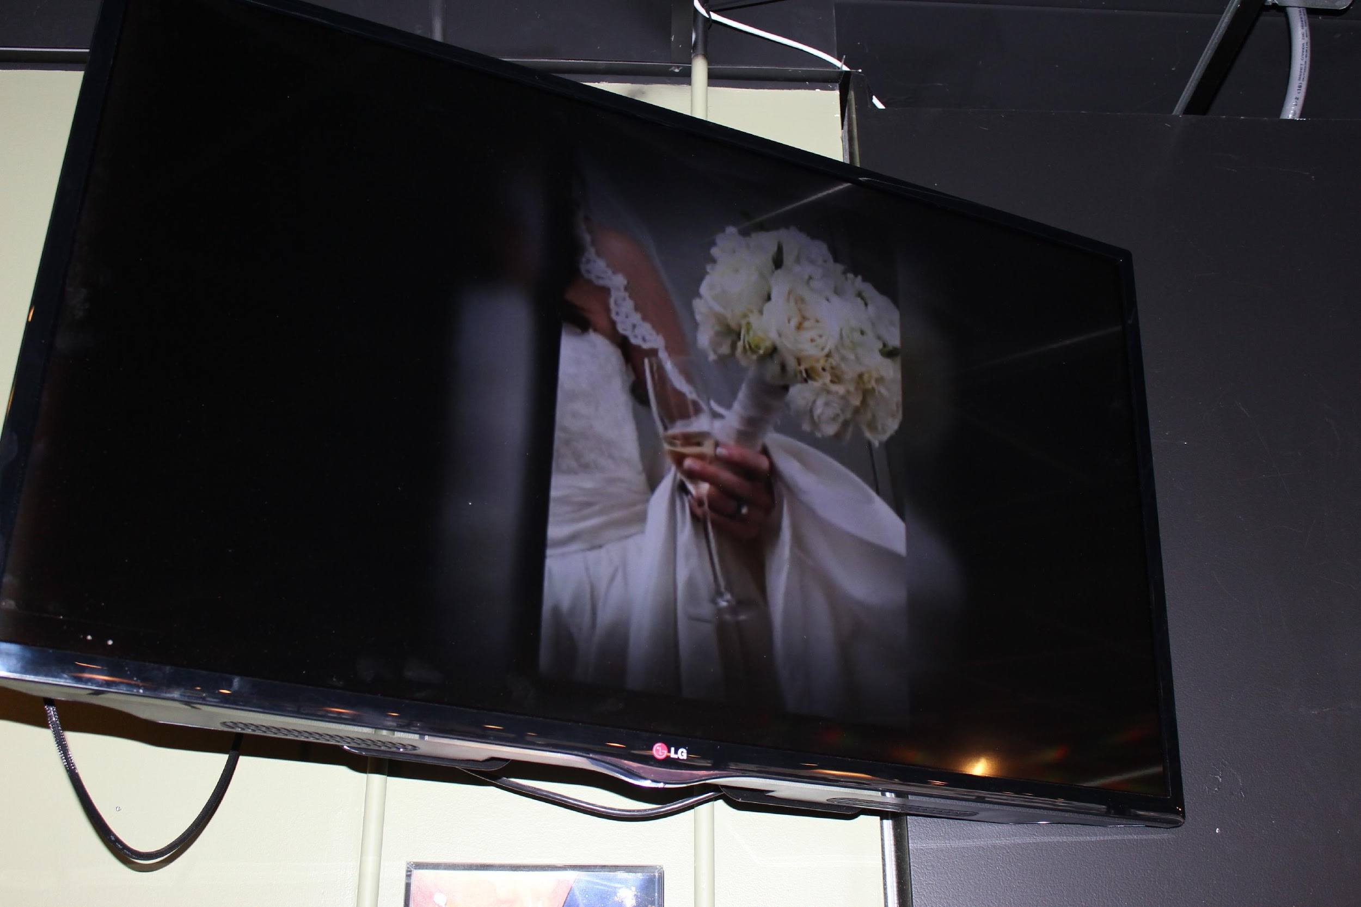
A Proper Consultation Room

Slide 9
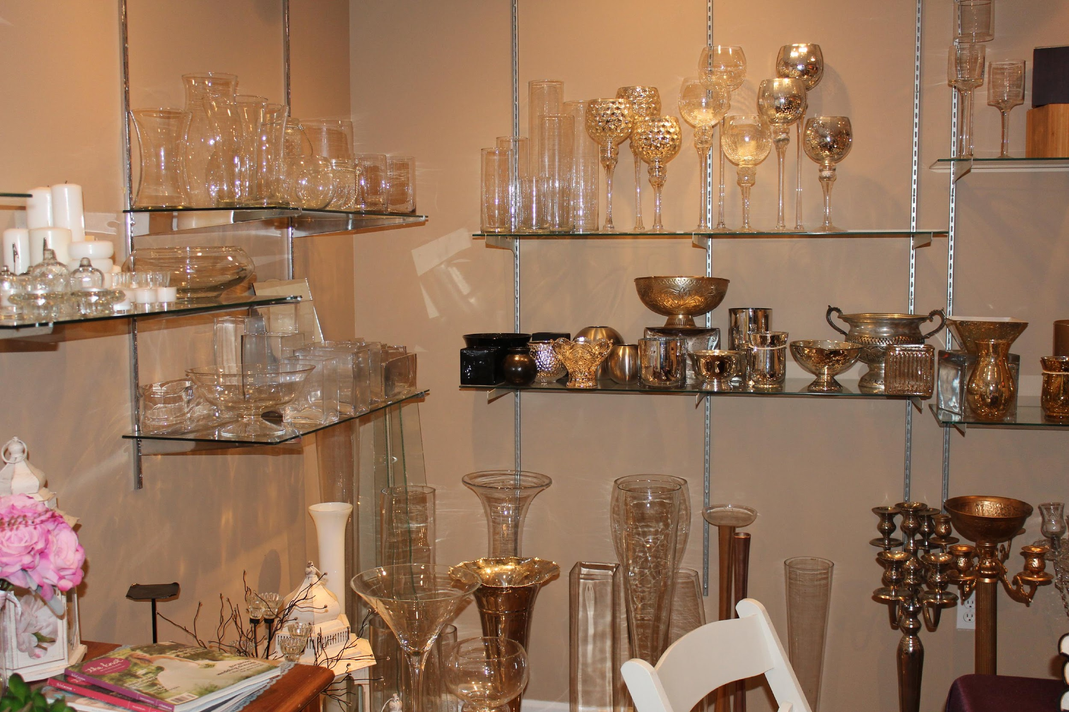
A Proper Consultation Room

Slide 10
The Consultation
-To charge or not to charge?
-The importance of customer service.
-Sell a look and a feel.
-Leave the details to us!
-Don’t be afraid to talk about money, it’s important!

Slide 11
The Importance of Strong Partnerships
-You must build relationships with other professionals!
- It is very important to build relationships with venues!
- It is also important to build relationships with people in the industry that you might need to utilize including lighting, tenting, linen rentals etc.
-It’s a give and take relationship! The idea is that they send referrals to you and you do the same!

Slide 12
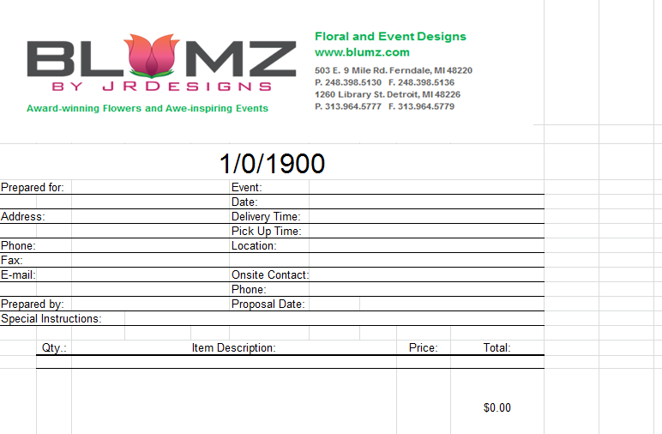
A Generic Proposal

Slide 13
Our Services Include:
Day of Coordination
Décor
Florals
Lighting
Linens
Officiant Services
Stationery
Tenting
Tuxedo Rental

Slide 14
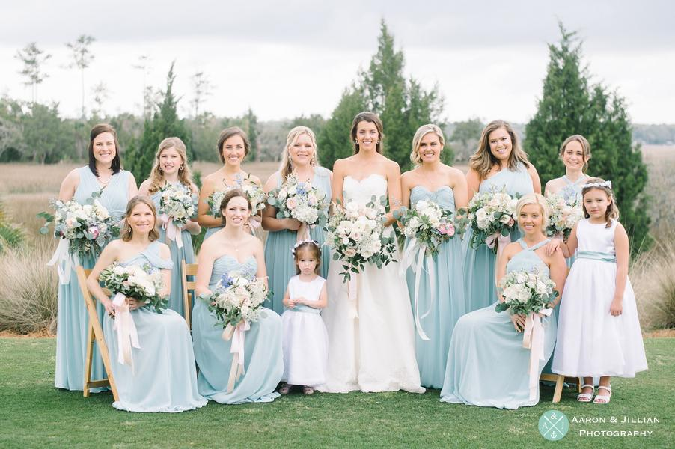
Blumz by JRDesigns Weddings

Slide 15
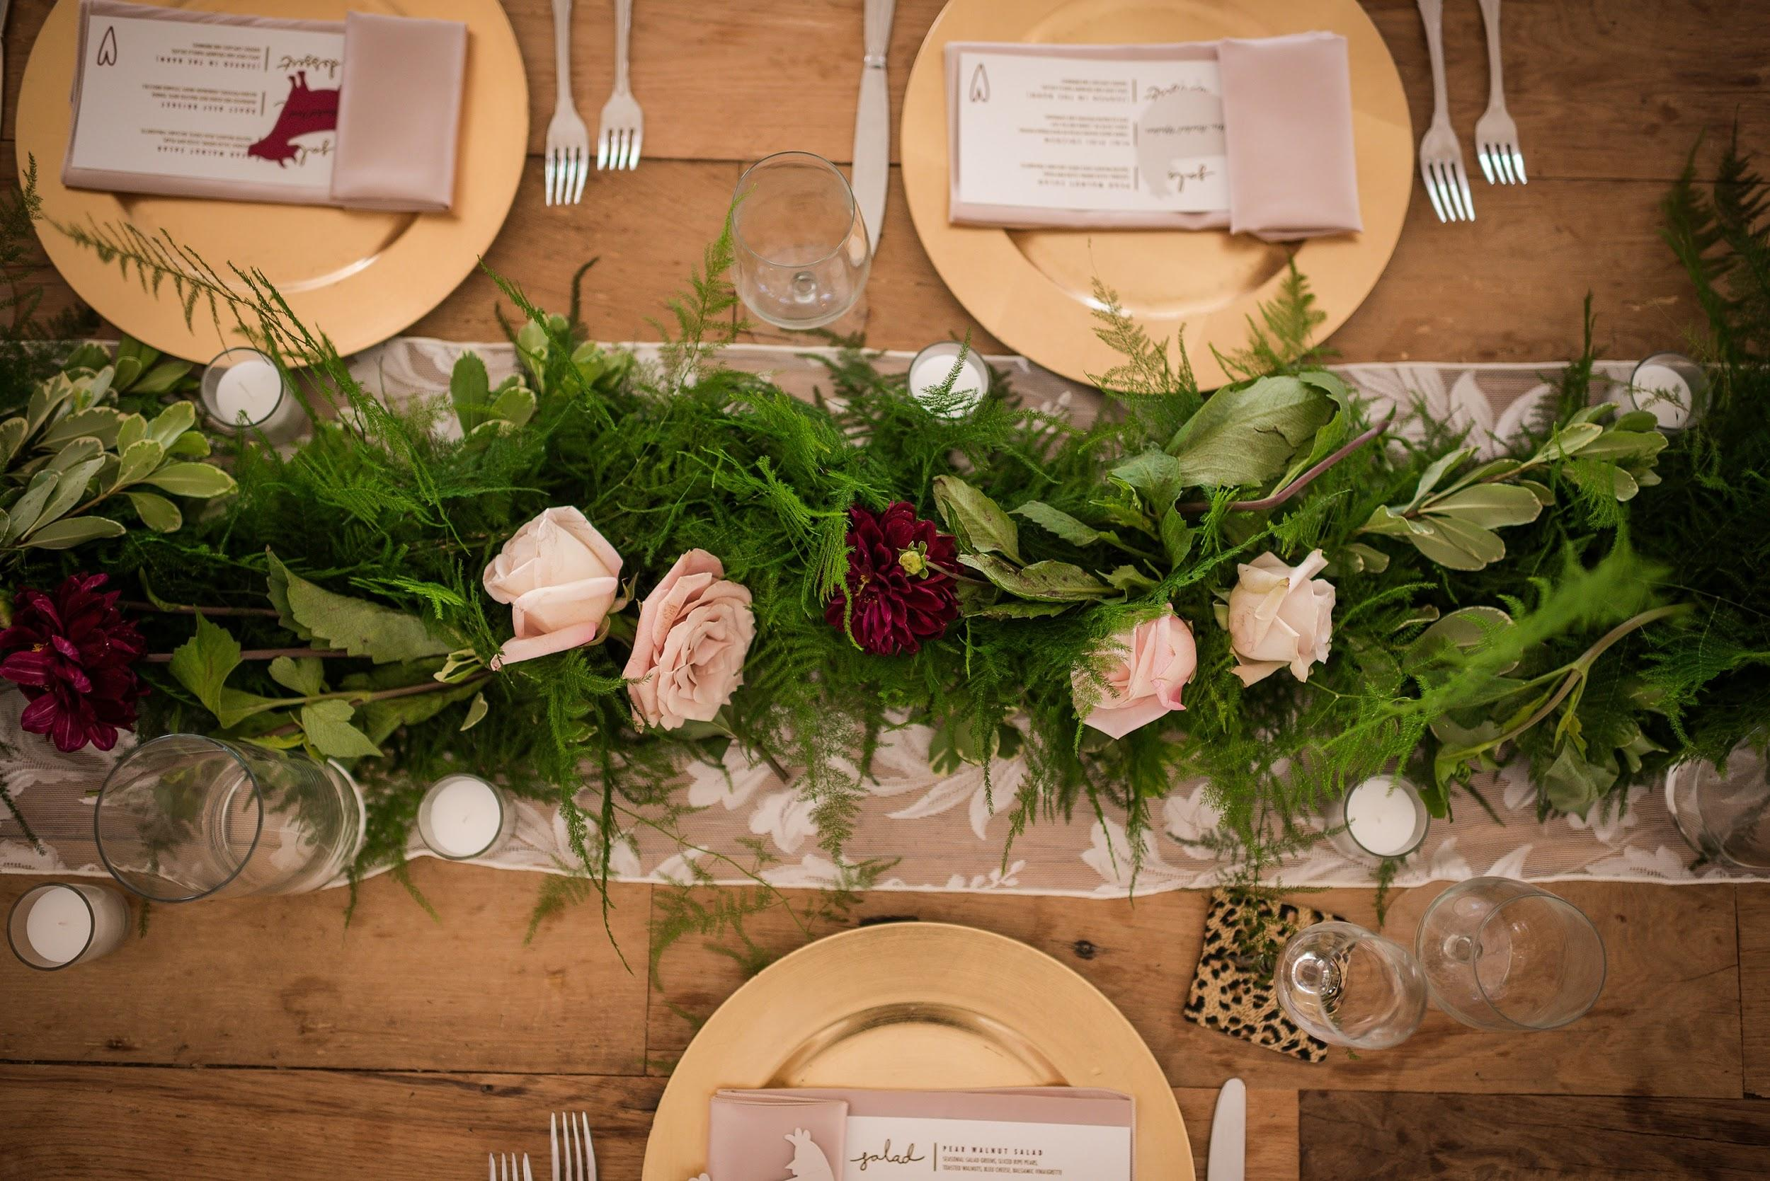

Slide 16
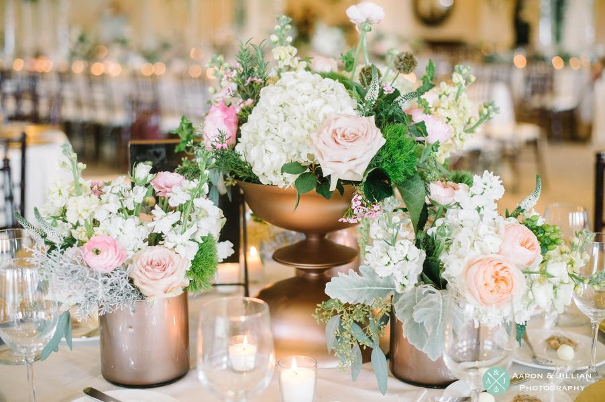

Slide 17
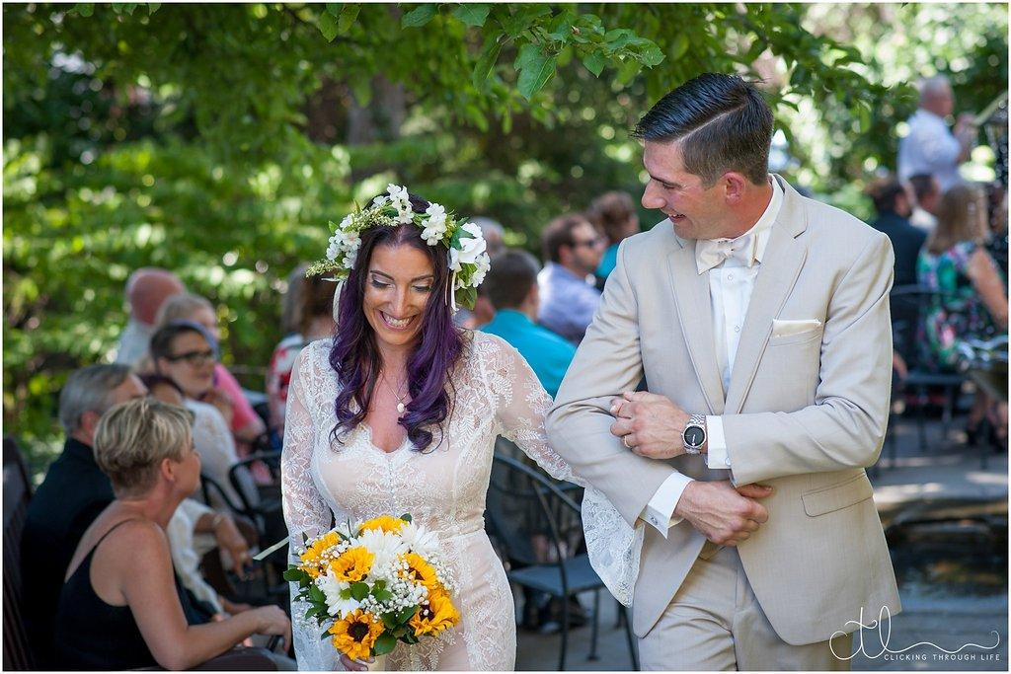

Slide 18
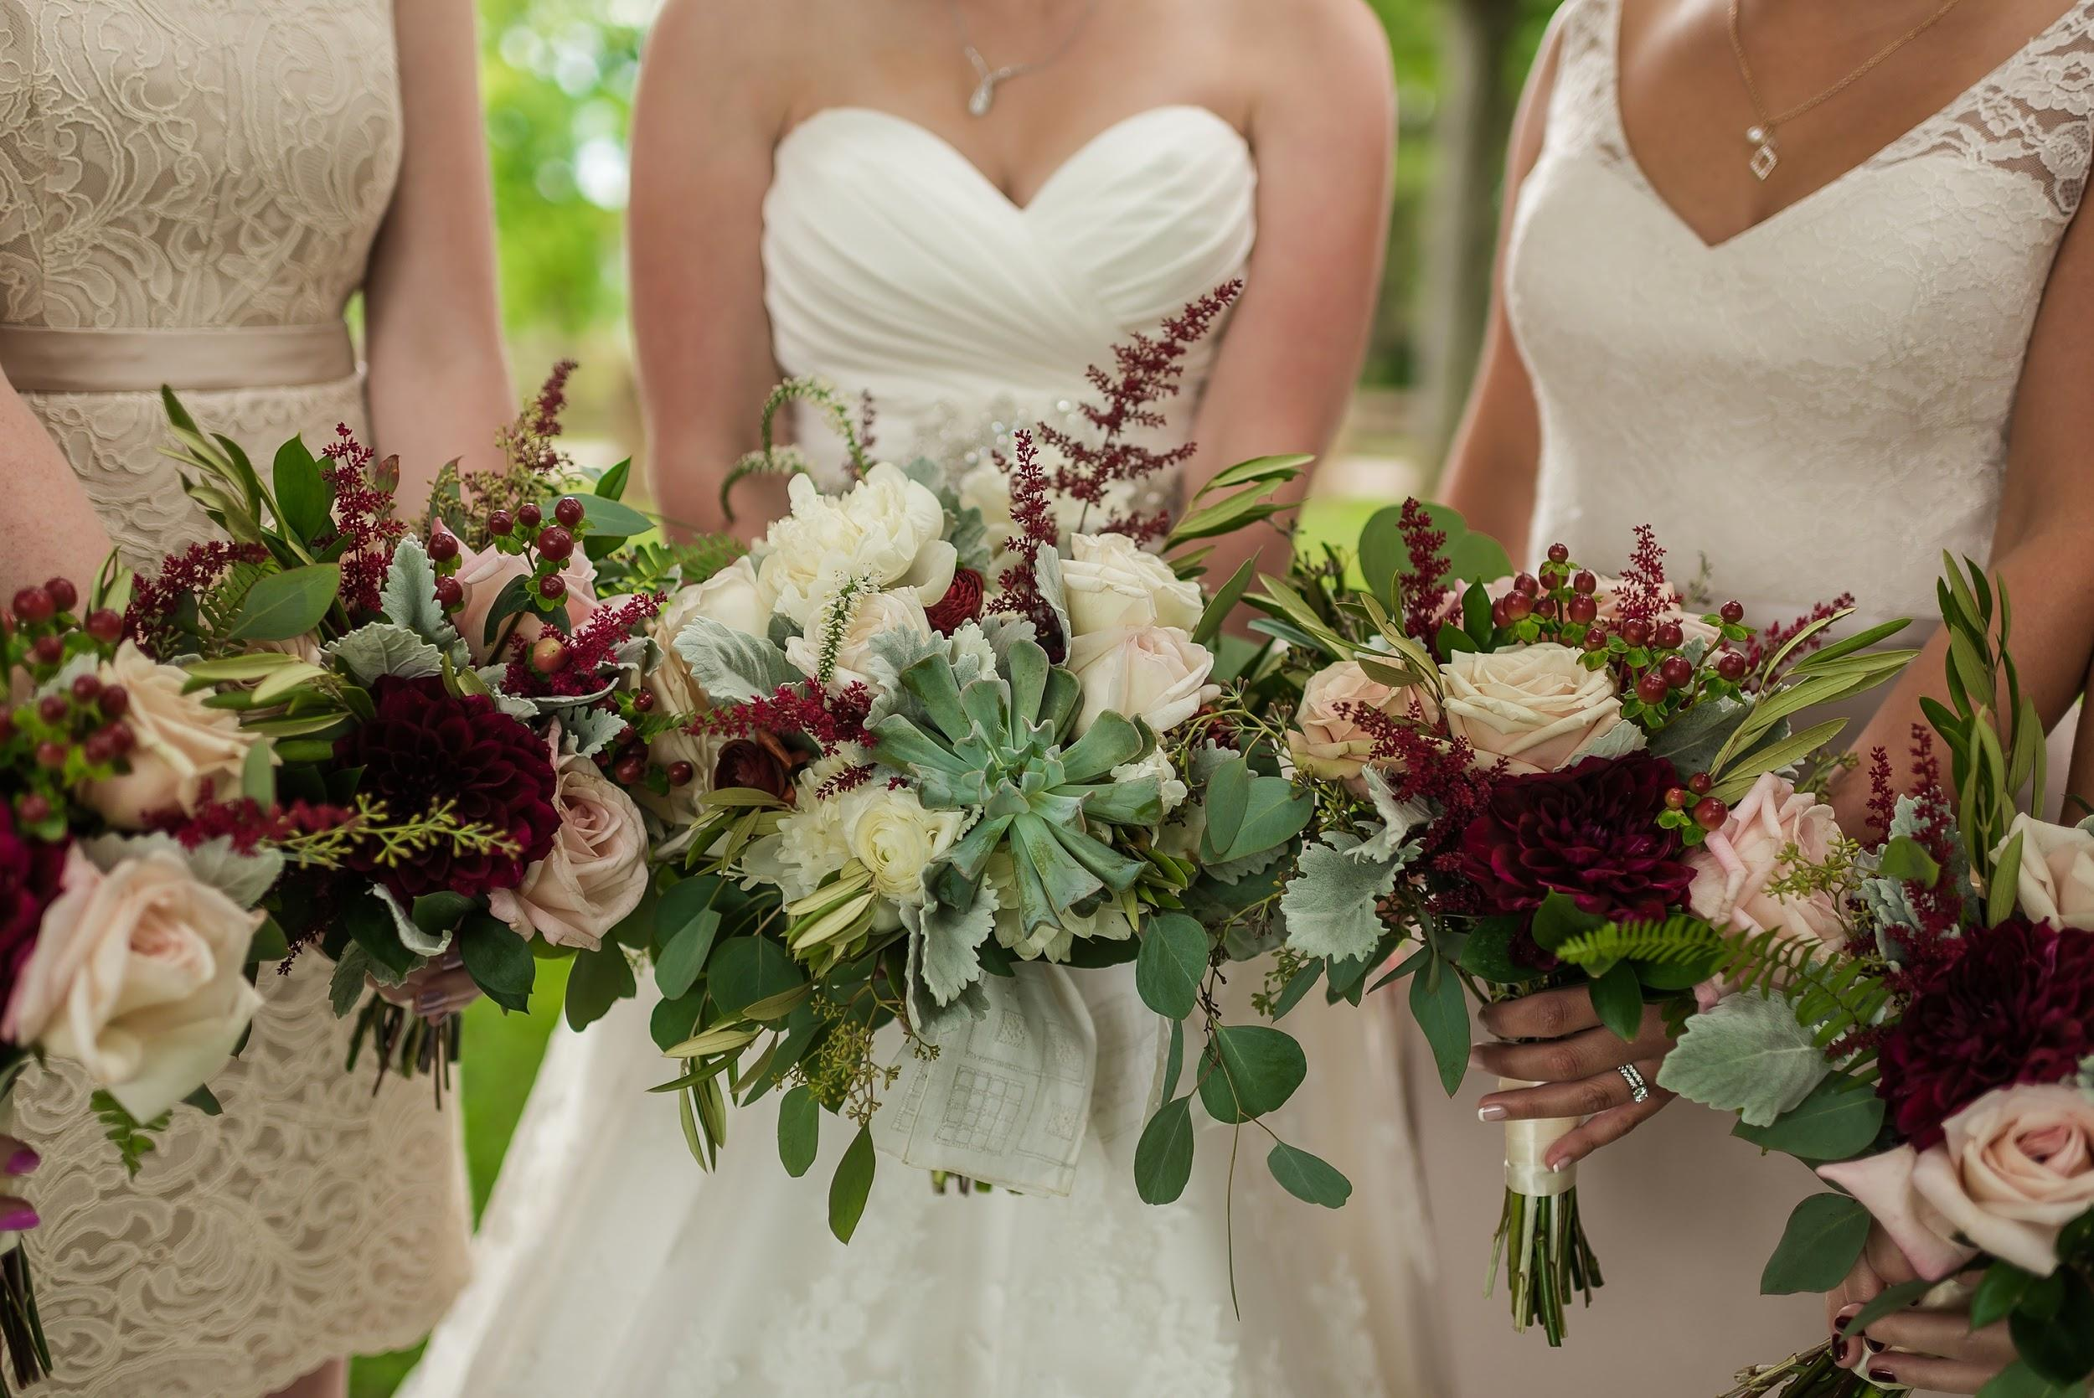

Slide 19
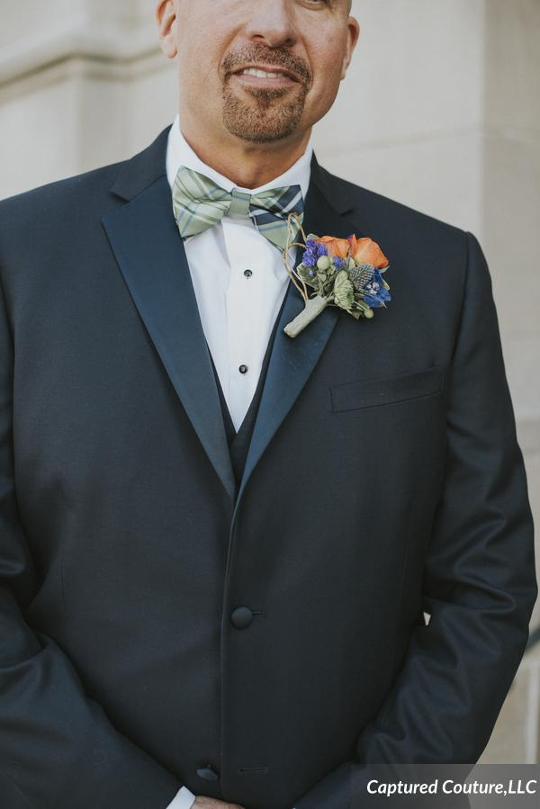

Slide 20
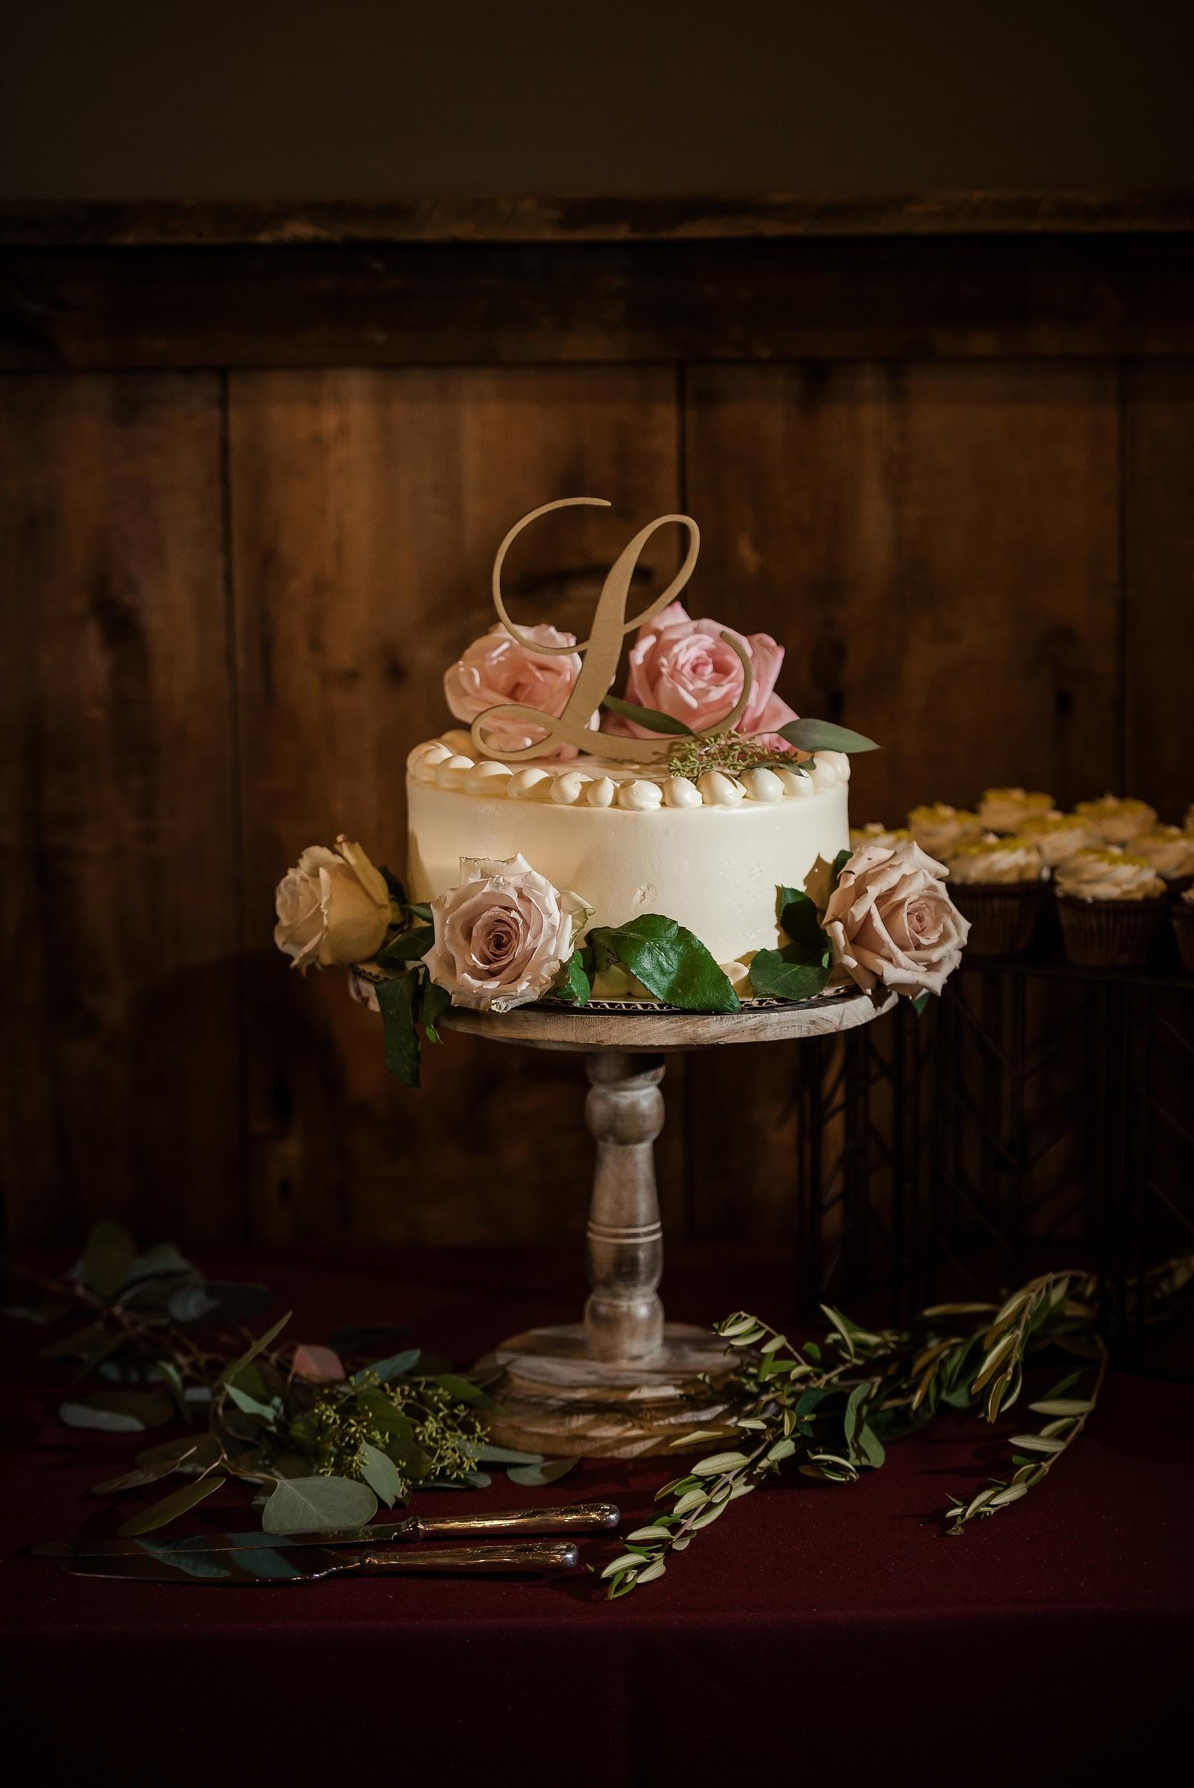

Slide 21
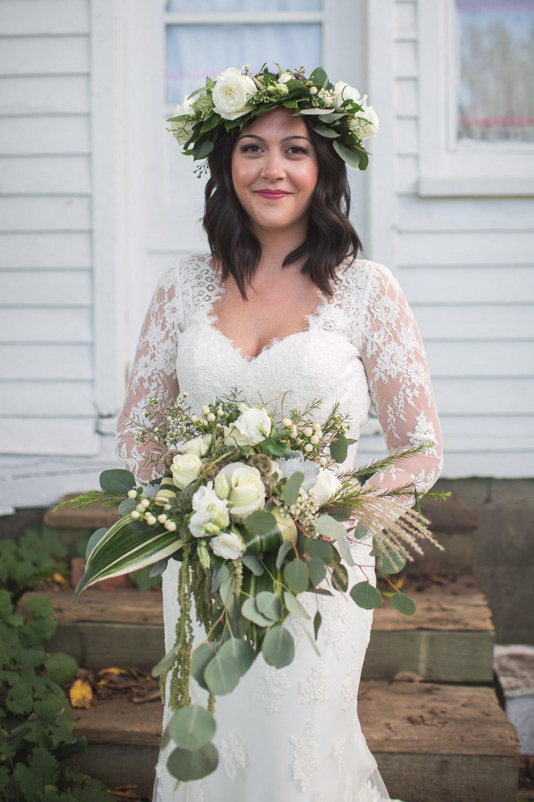

Slide 22
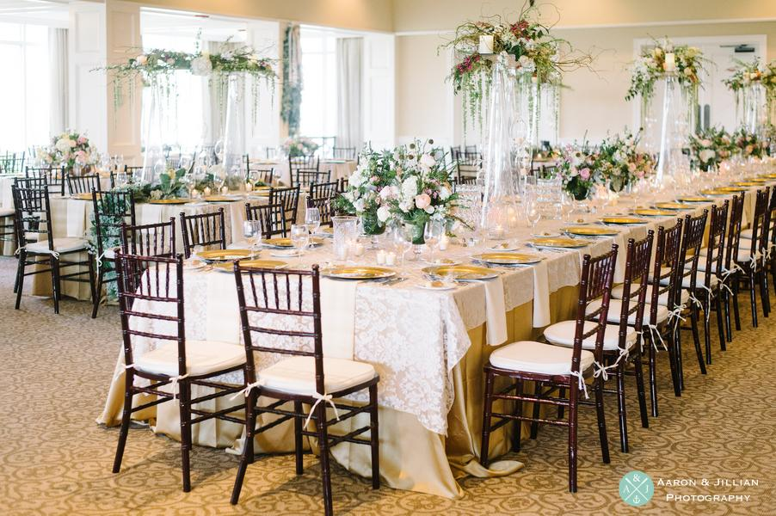

Slide 23
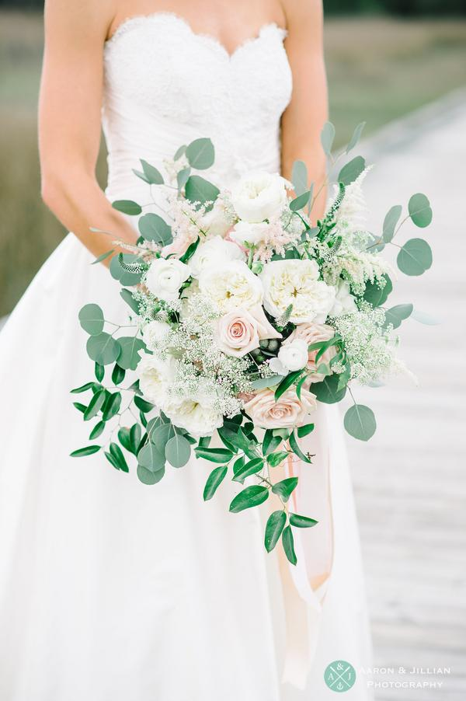

Slide 24
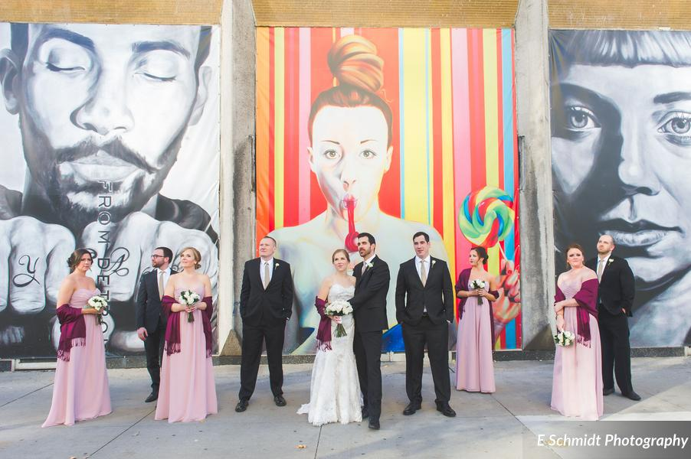

Slide 25
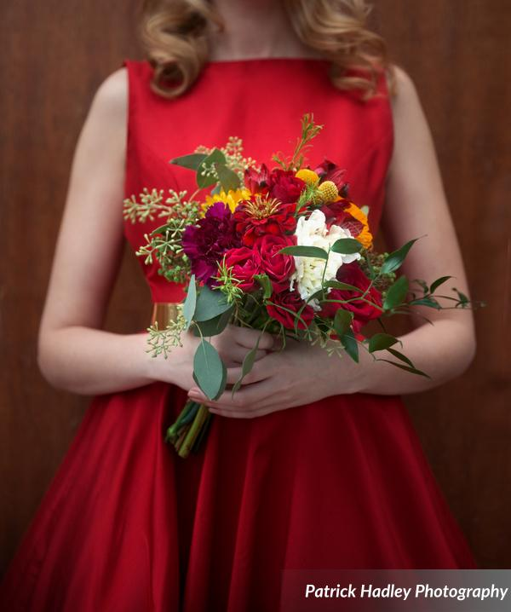

Slide 26
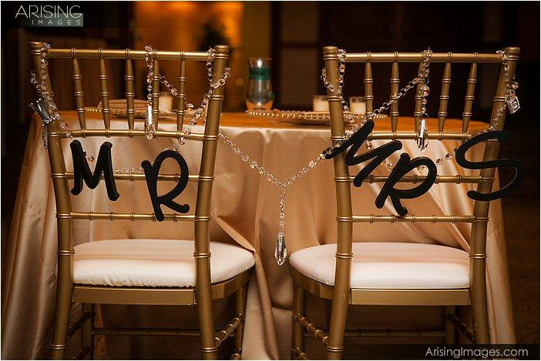

Slide 27
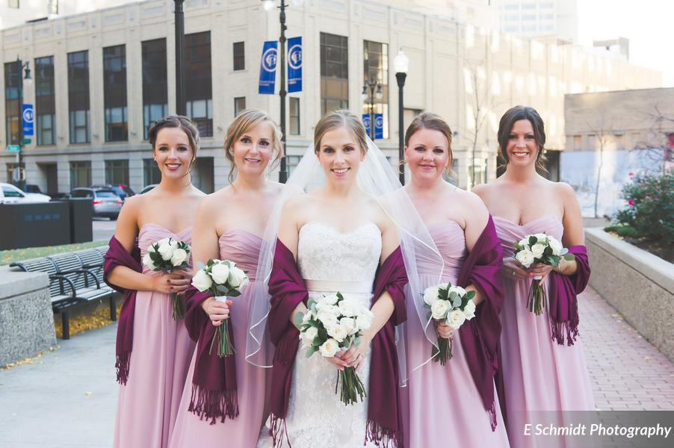

Slide 28
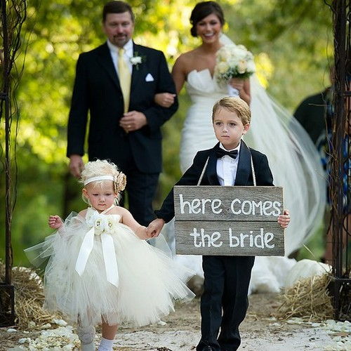

Slide 29
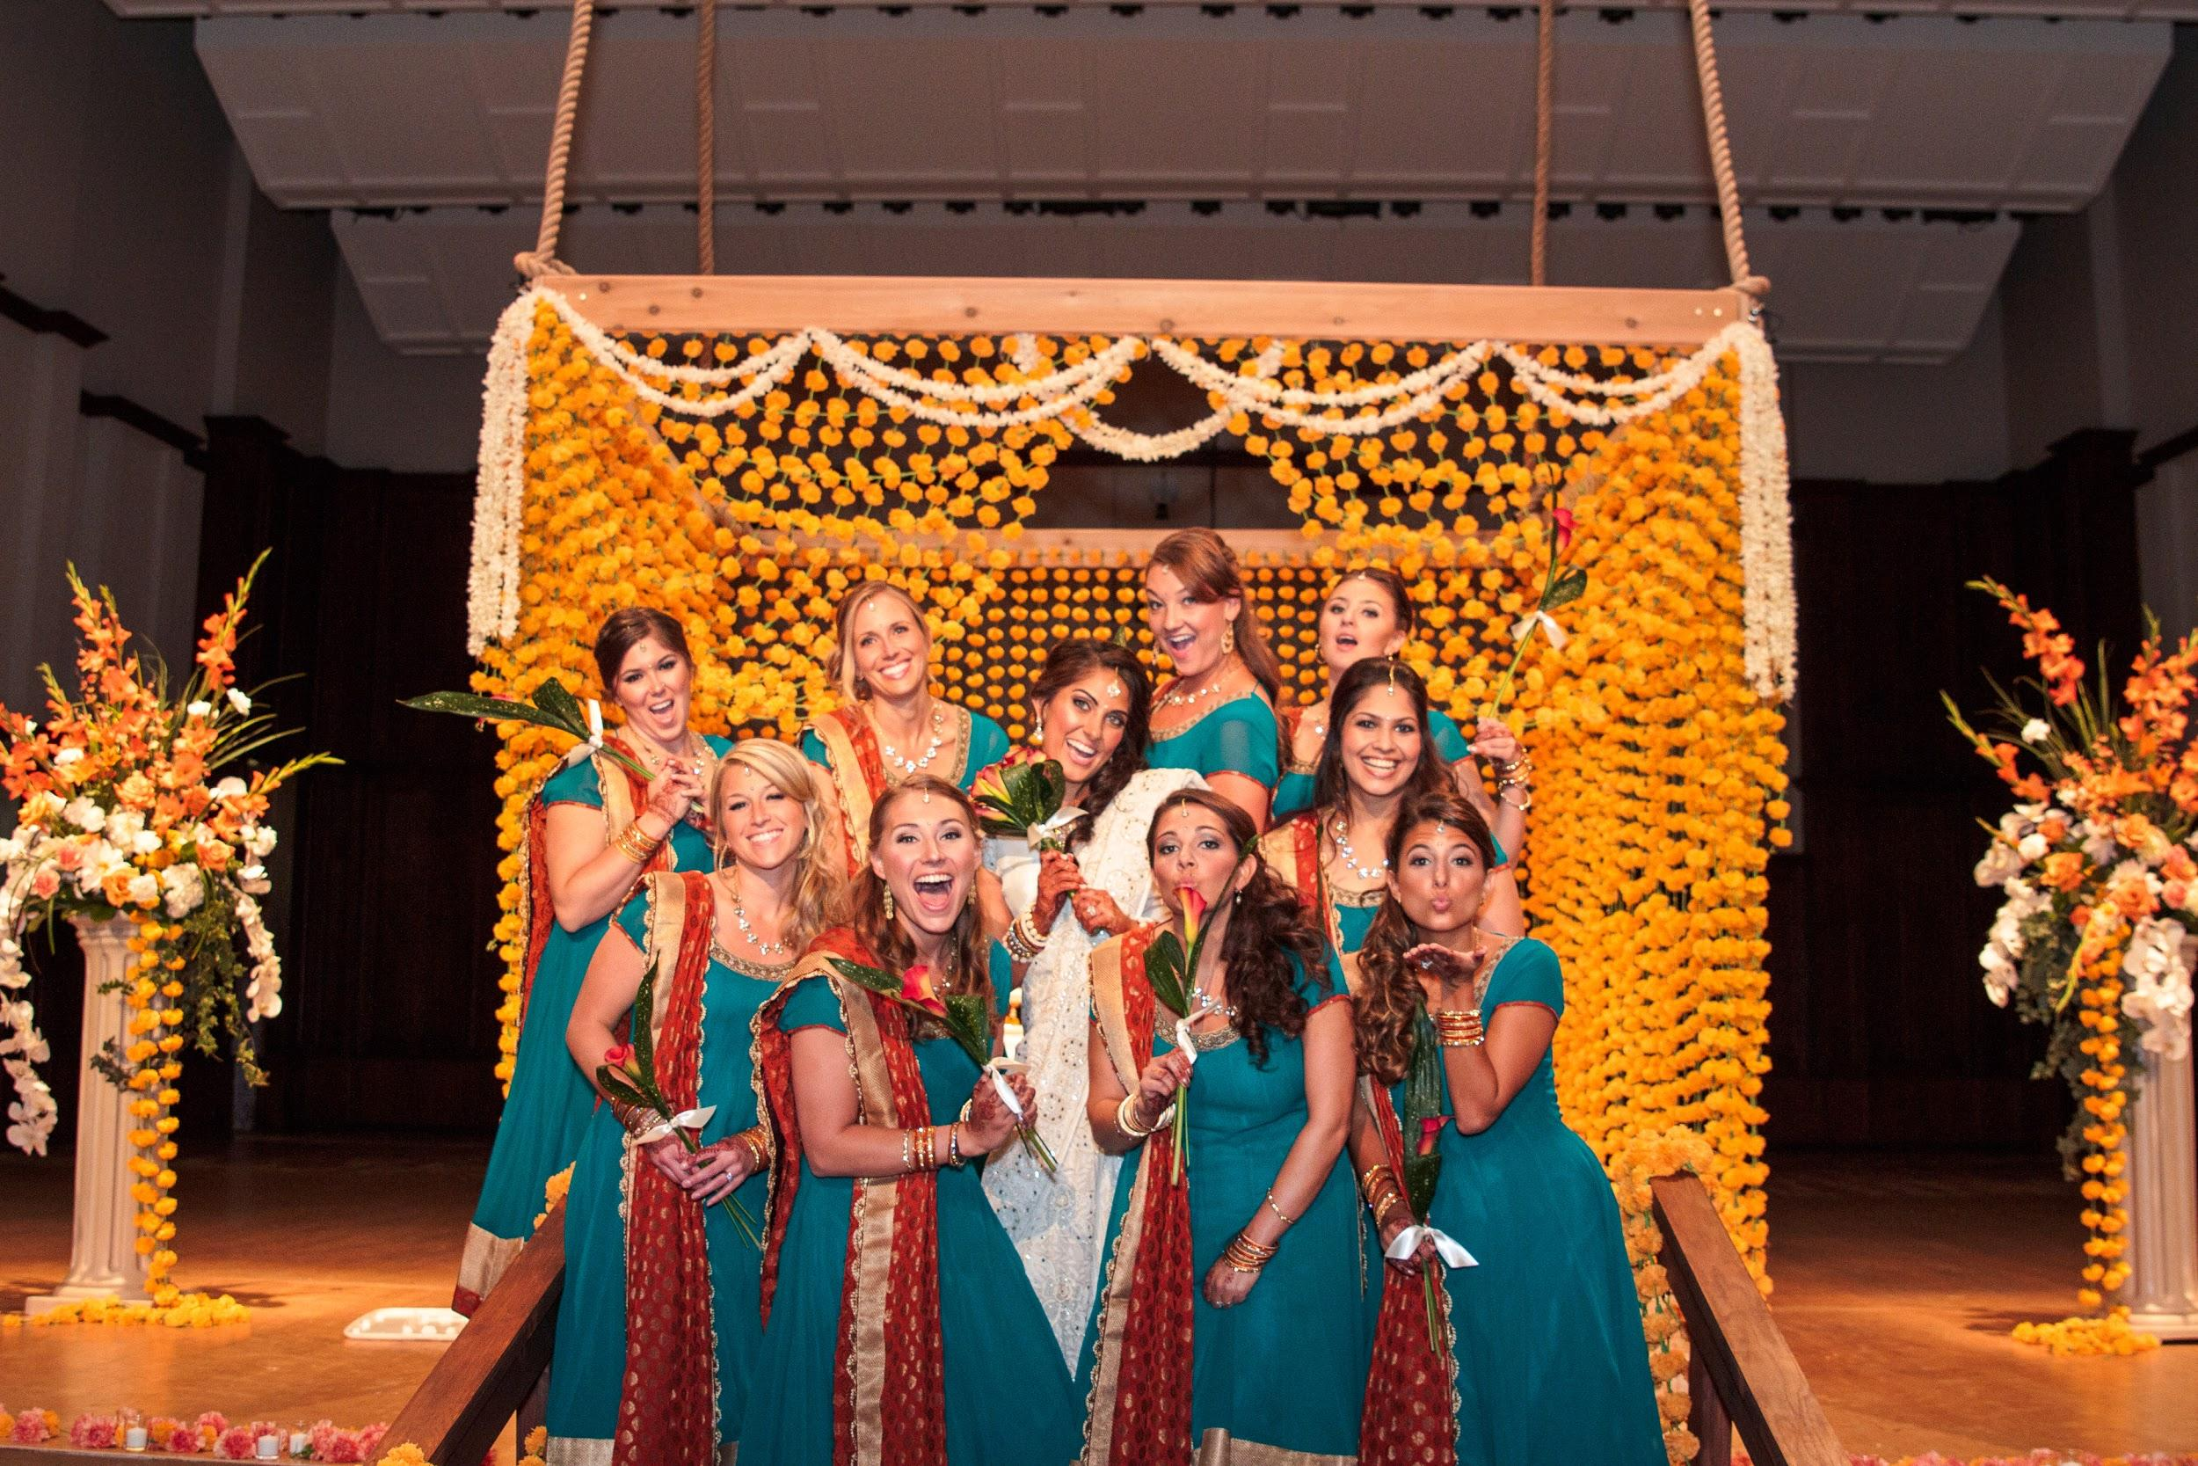

Slide 30
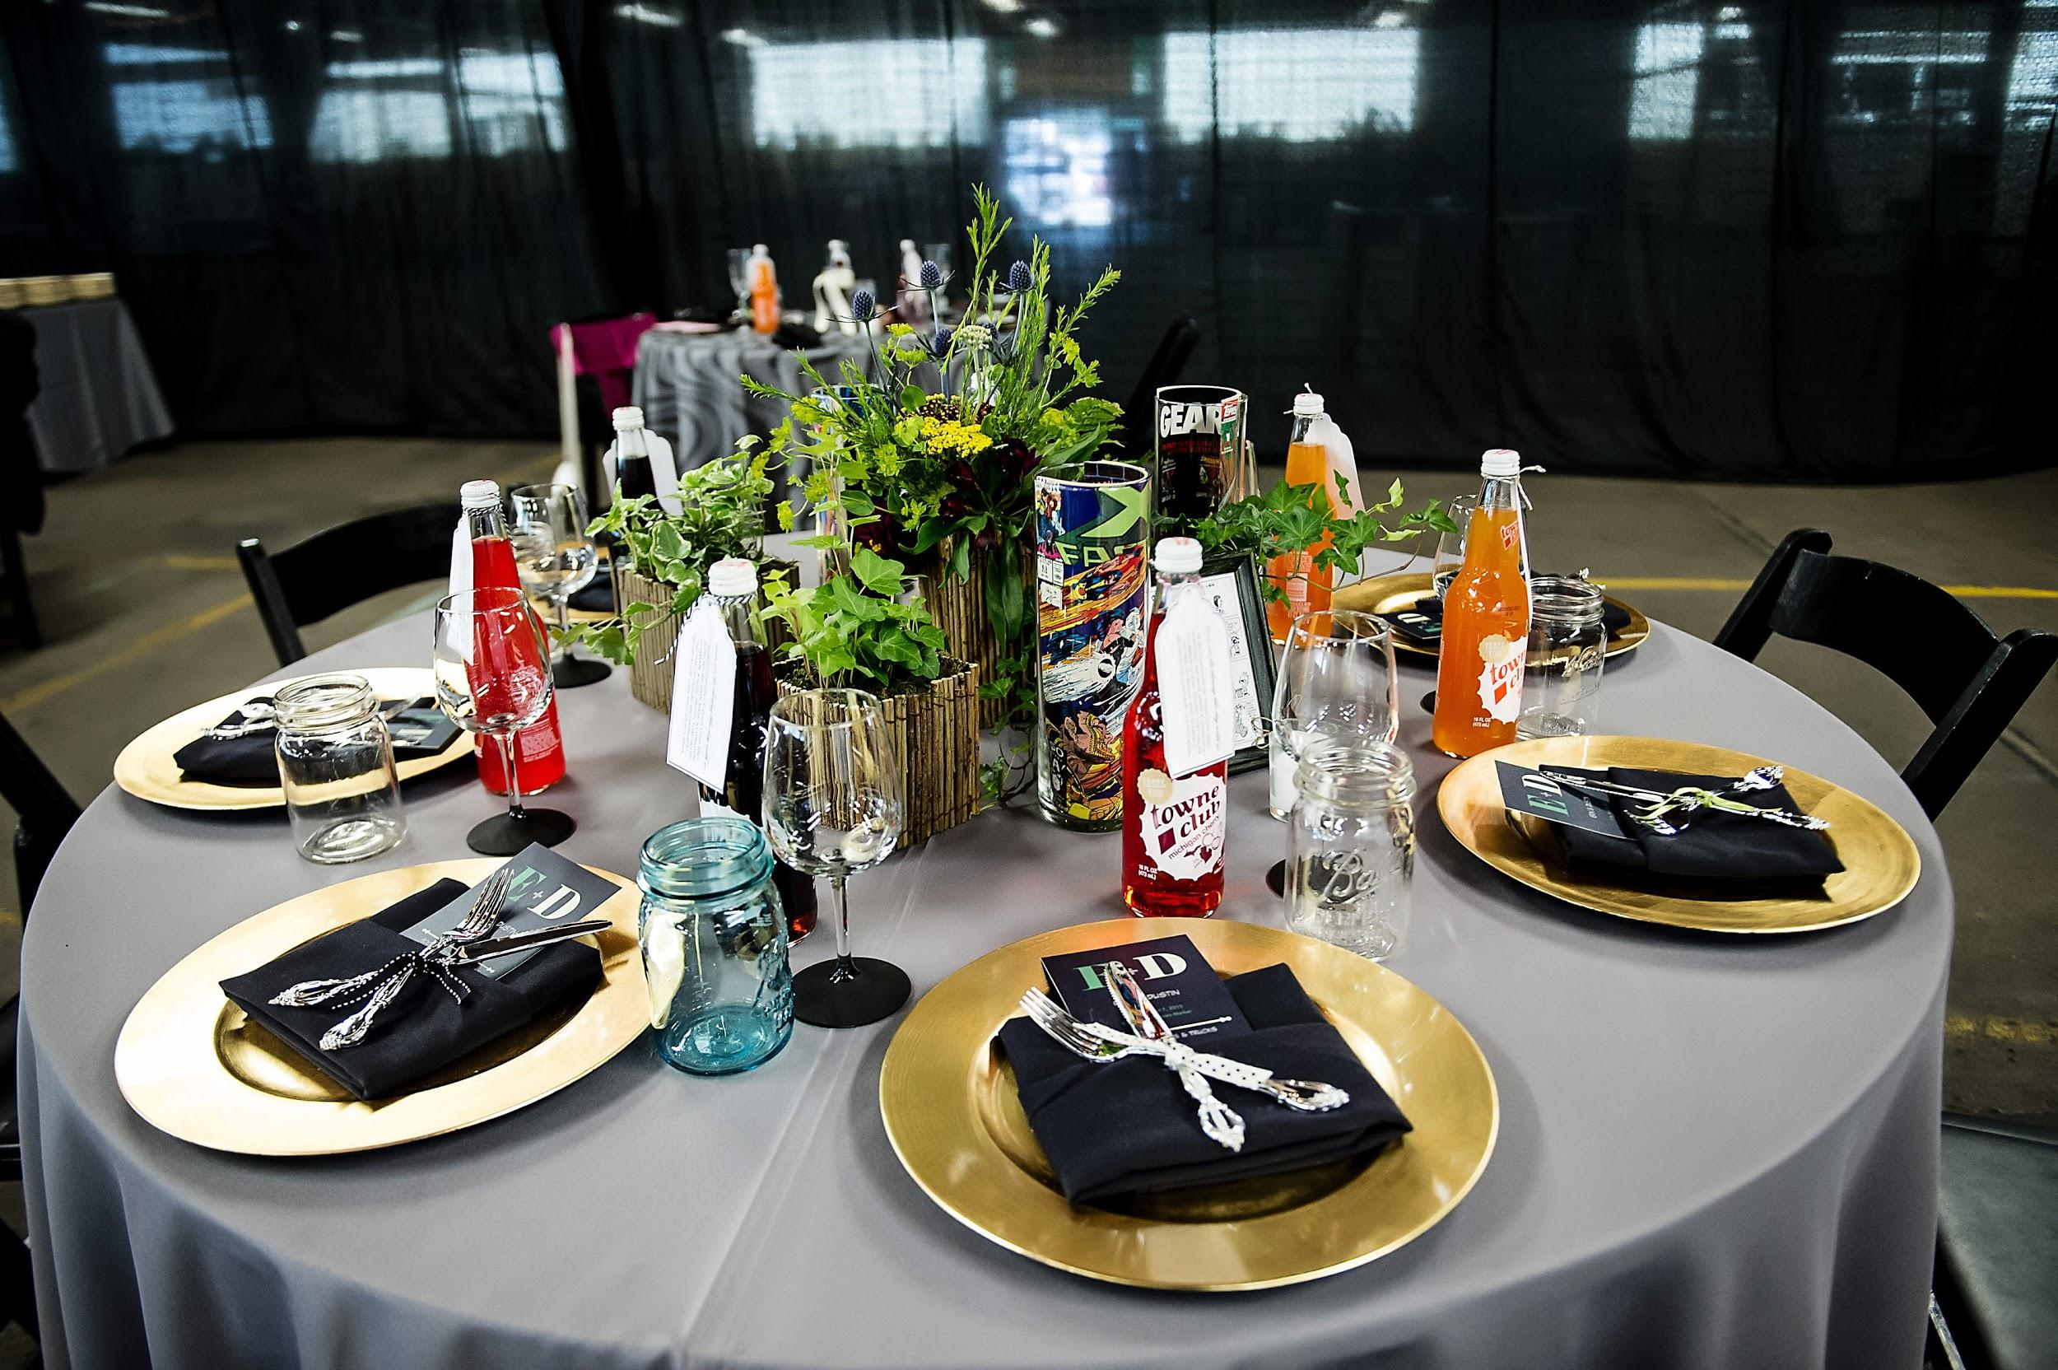

Slide 32
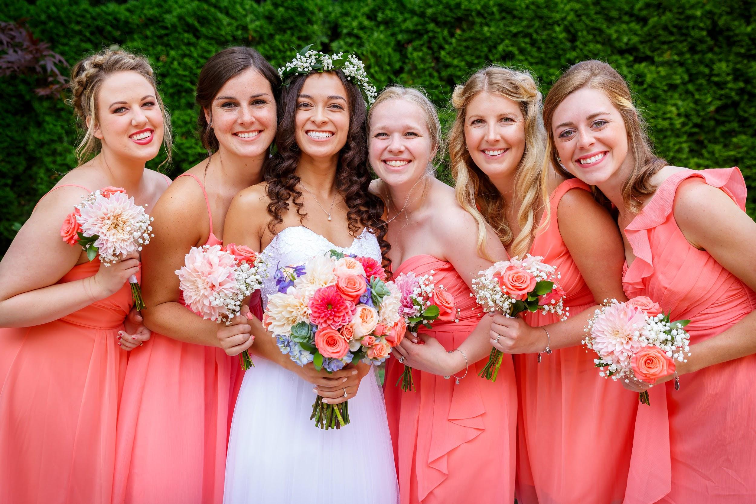

Slide 33
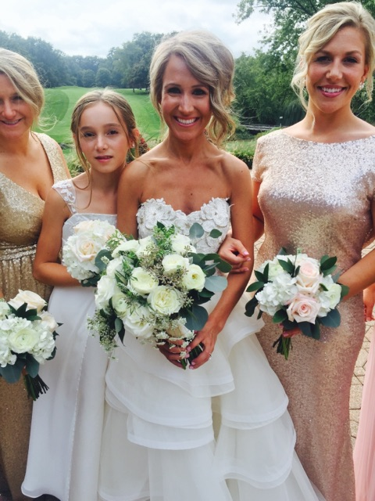

Slide 34
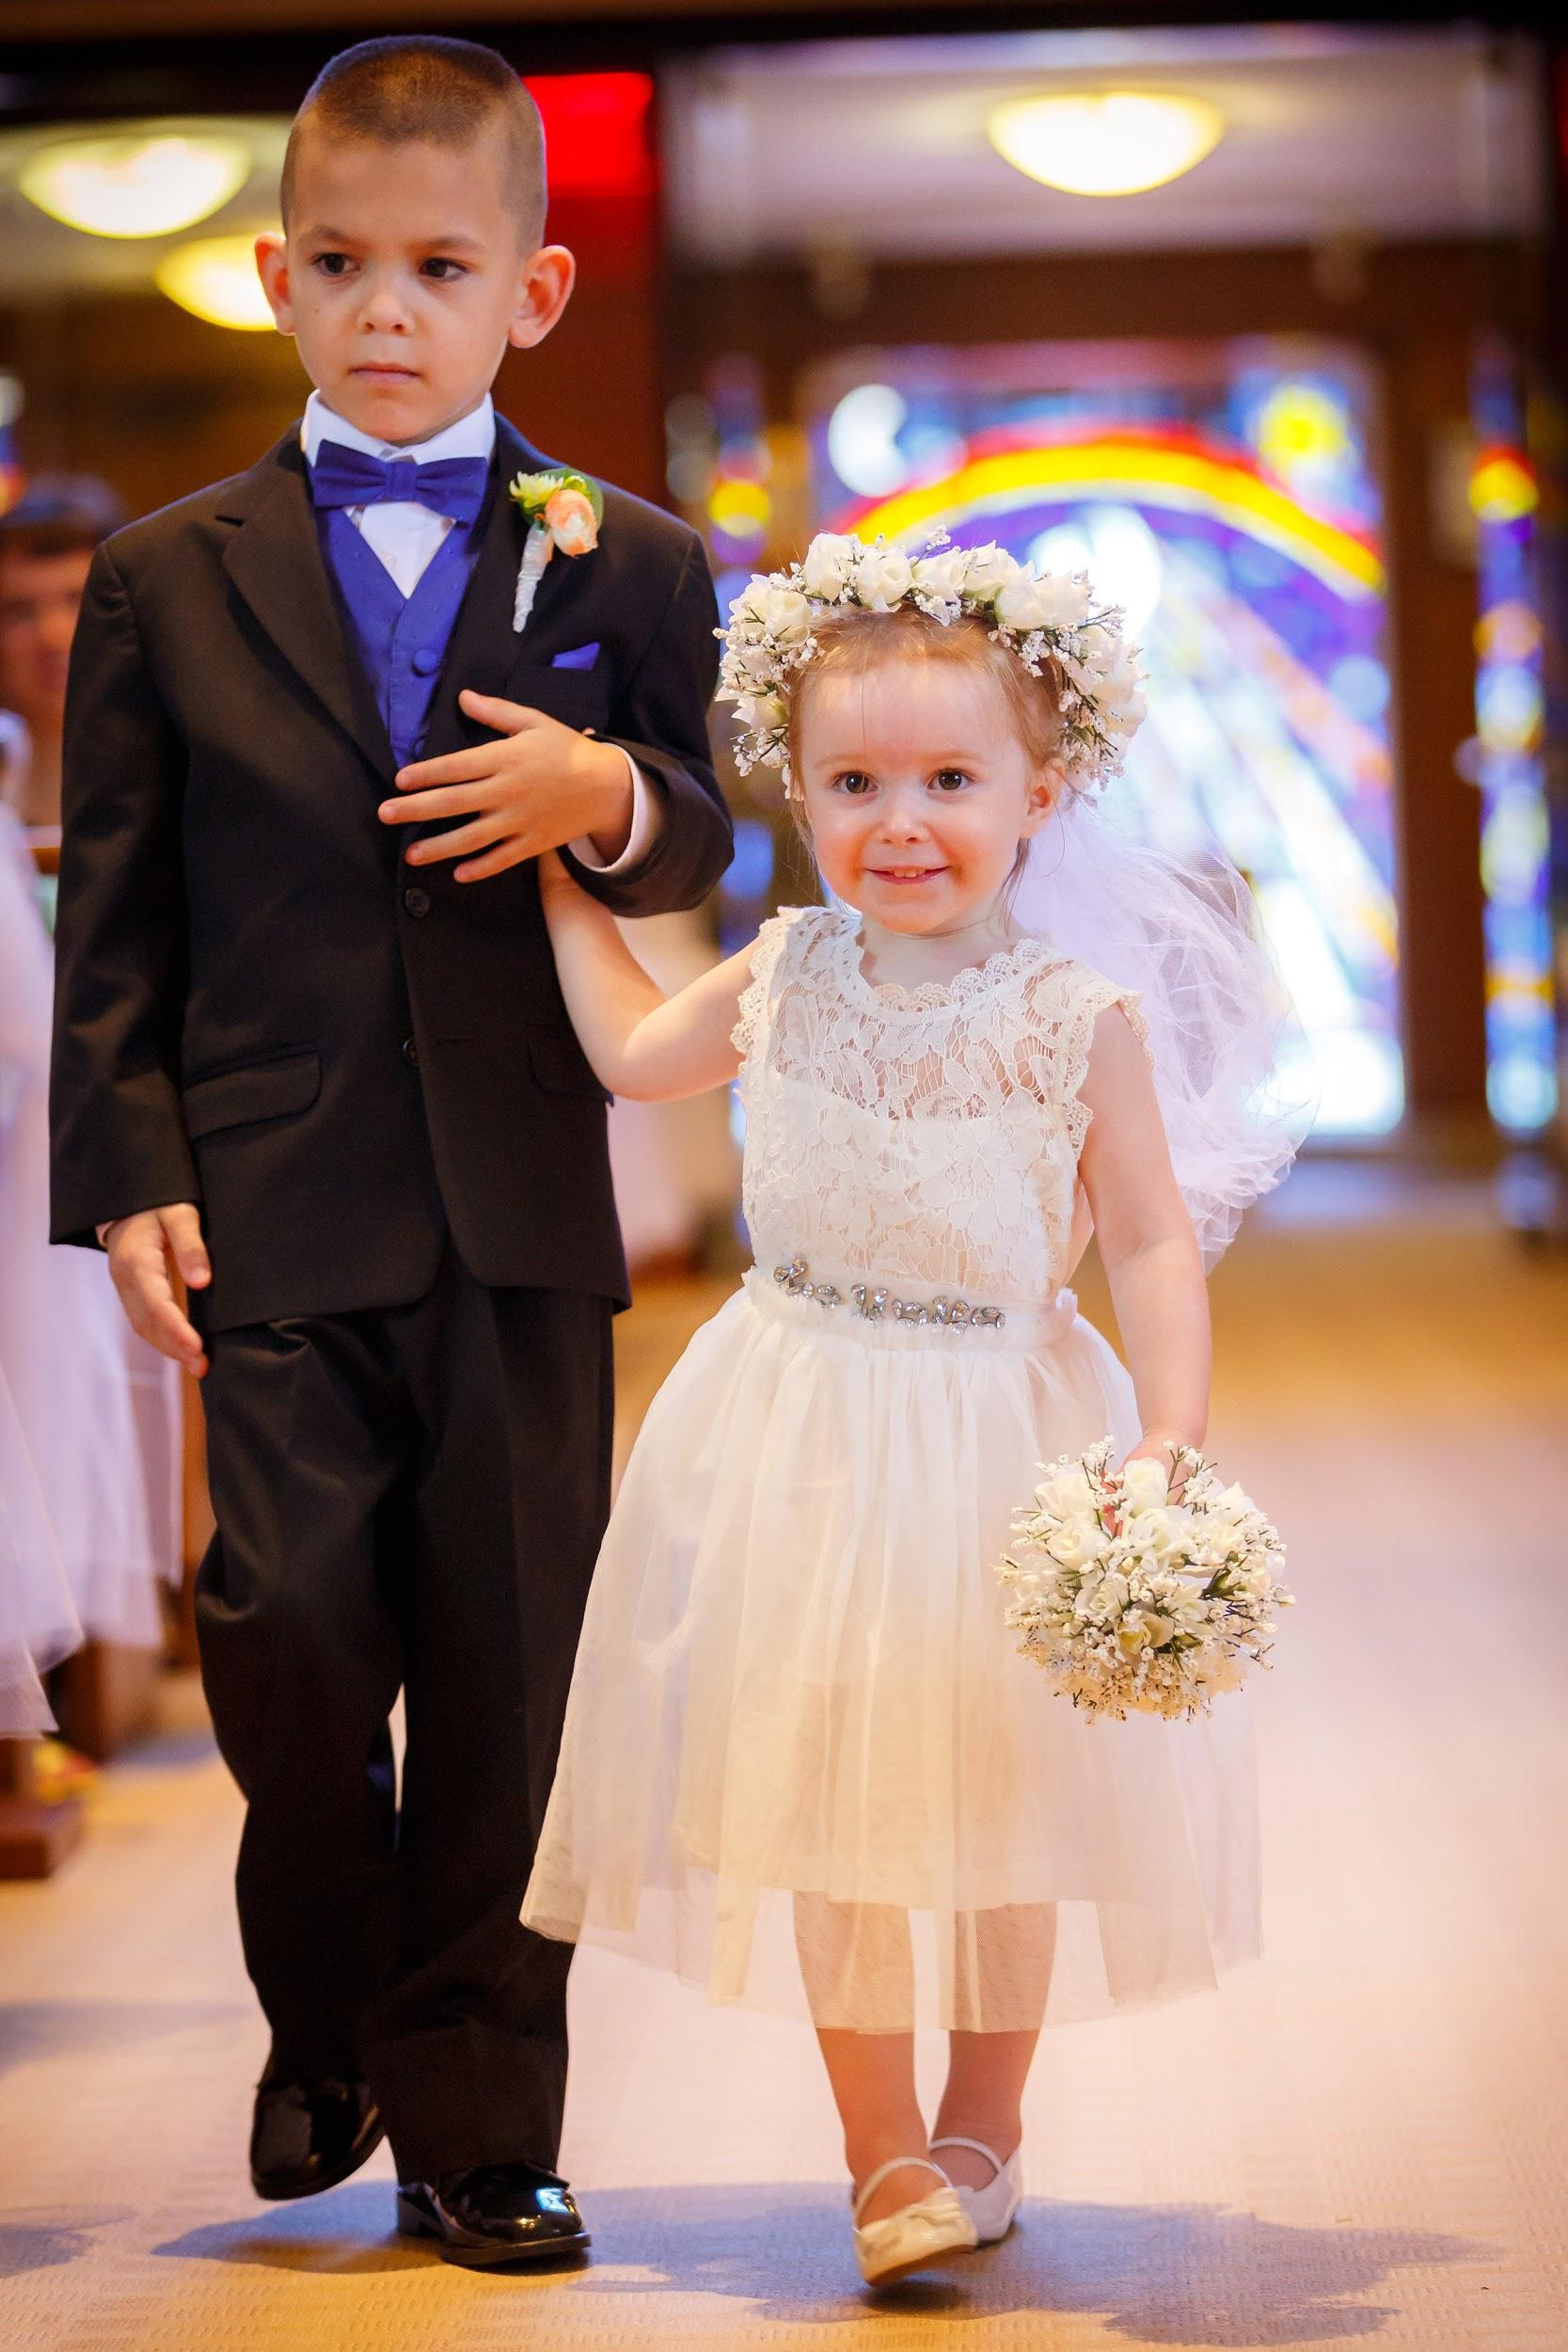

Slide 35
Wedding Trends:

Slide 36
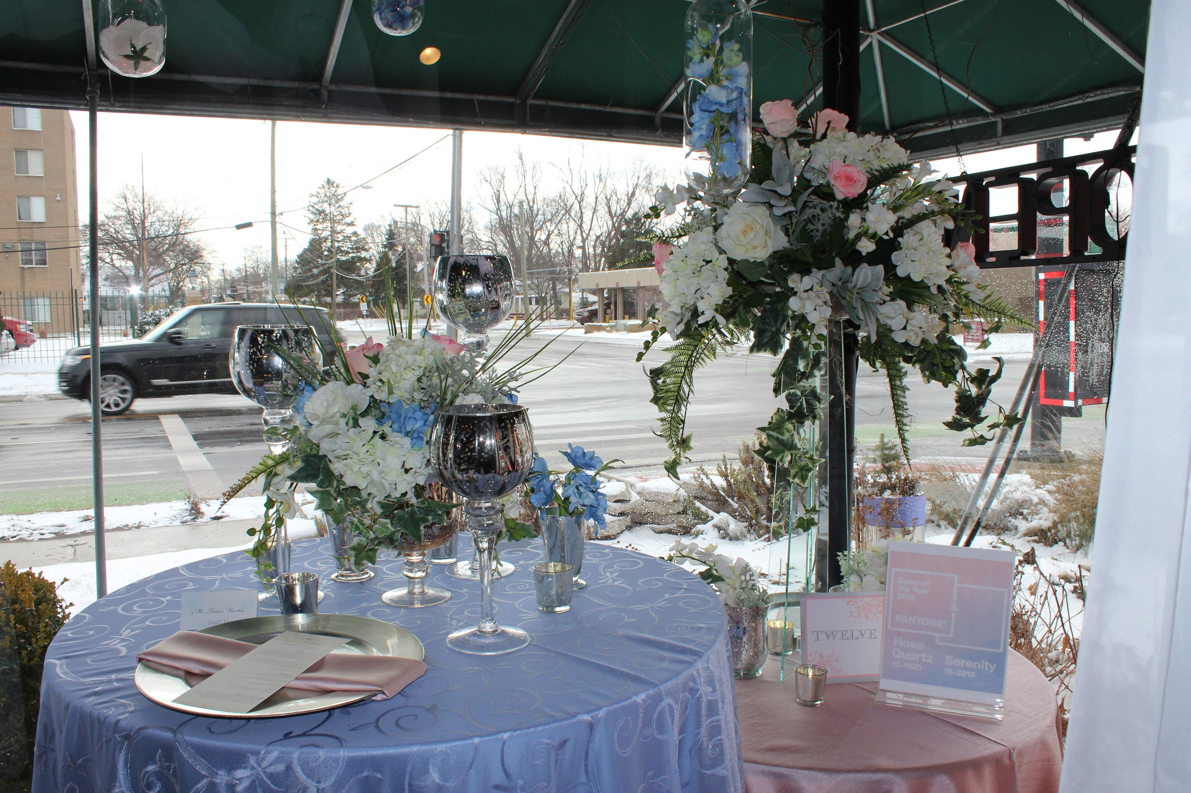
Pantone Colors of the Year
Rose Quartz and Serenity

Slide 37
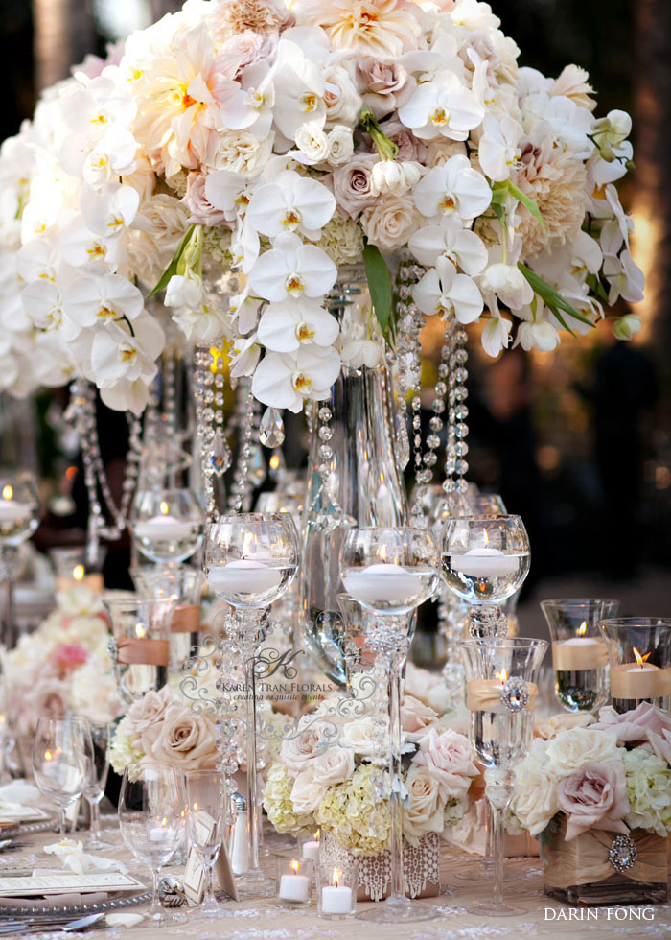
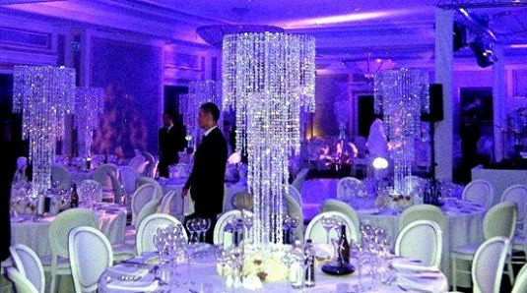
Crystal

Slide 38
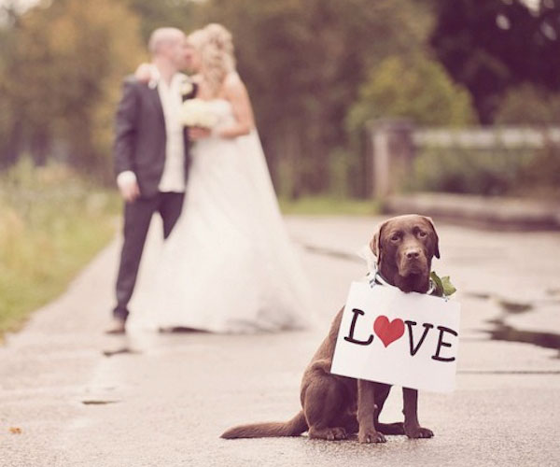
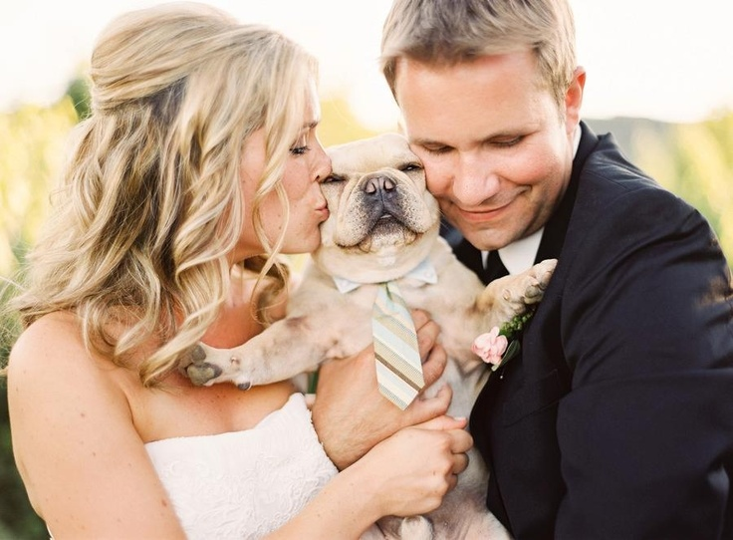
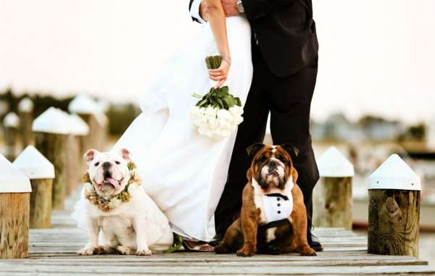
Including pets in the ceremony

Slide 39
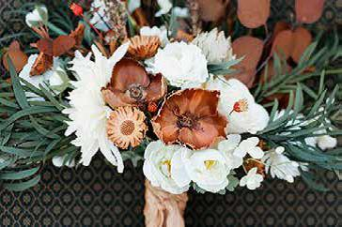
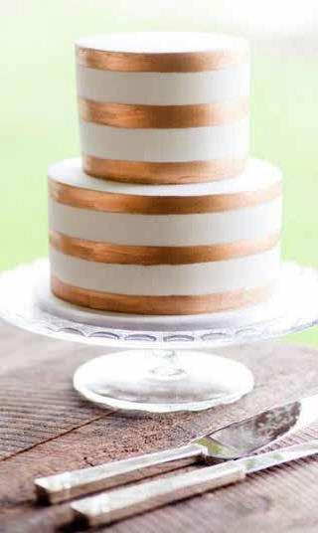
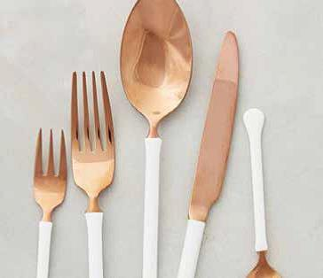
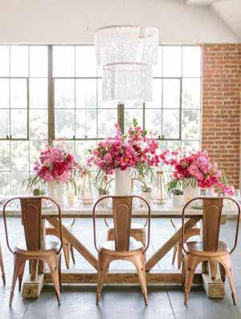
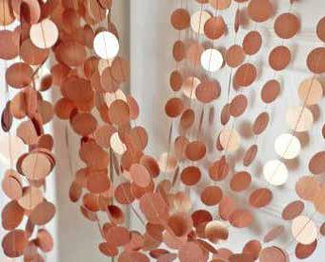
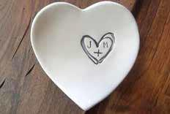
Subtle Sheen

Slide 40
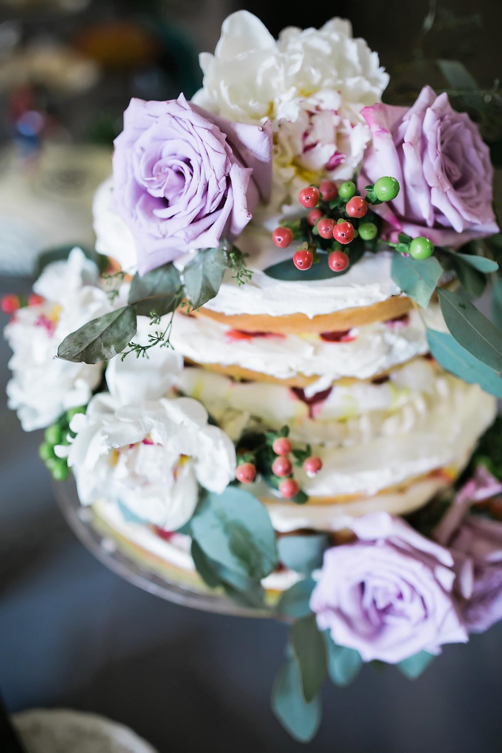
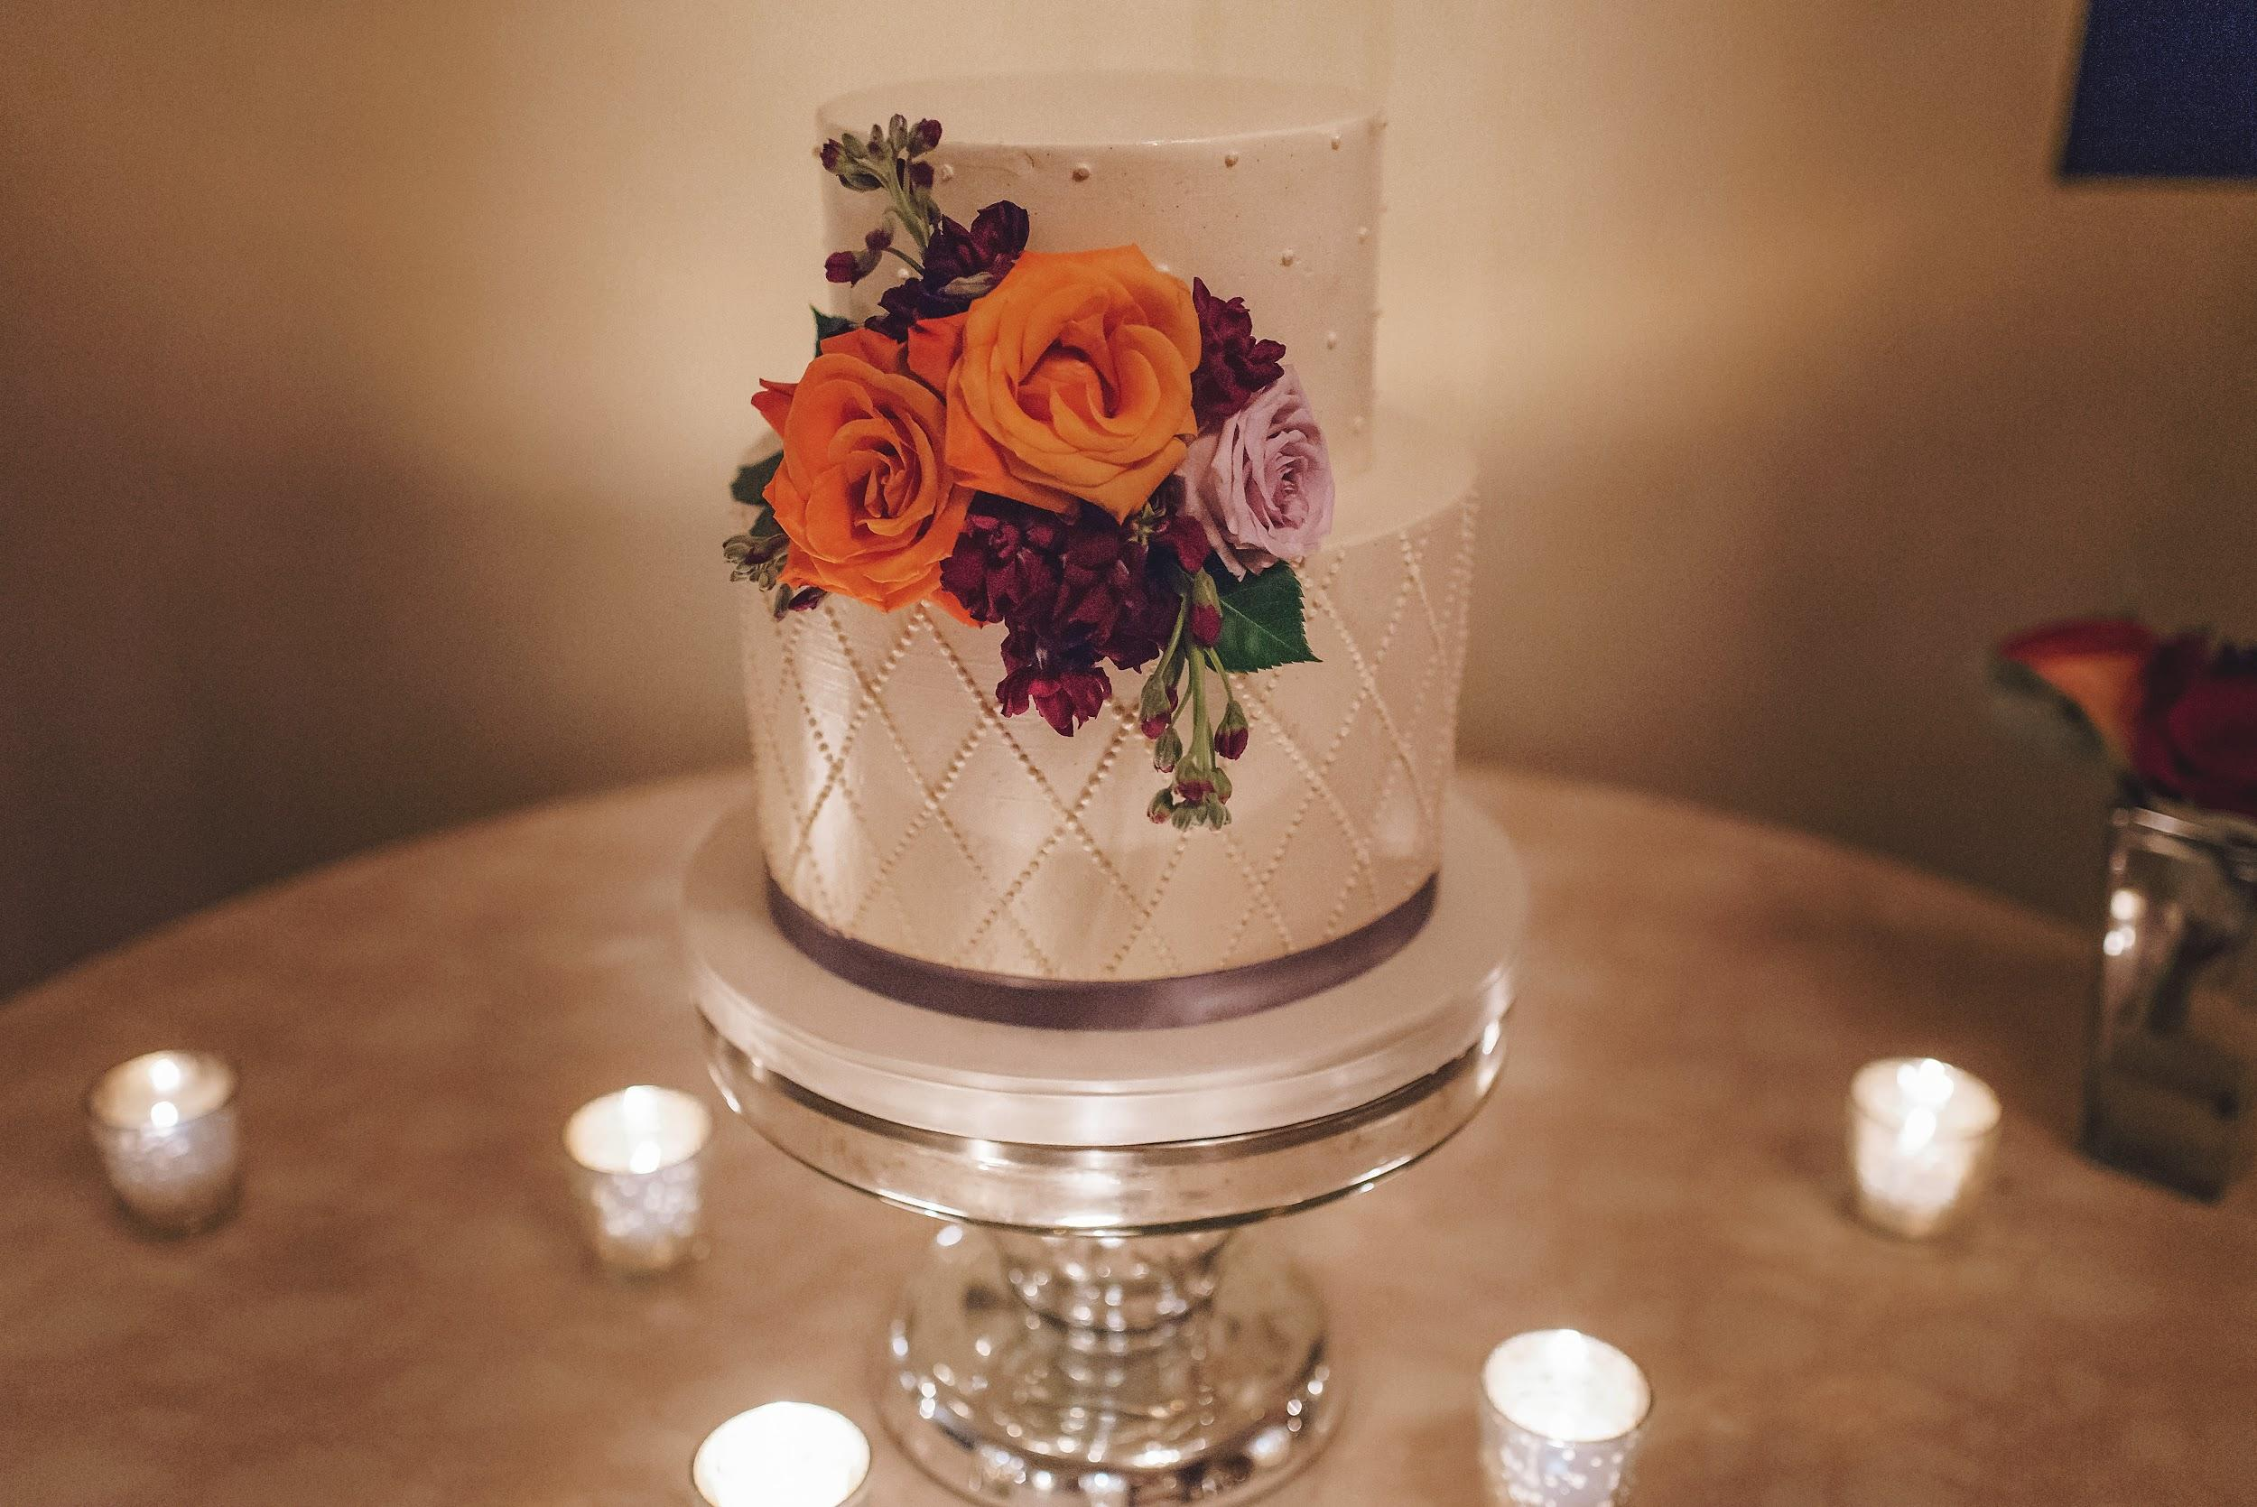
Naked Cakes

Slide 41
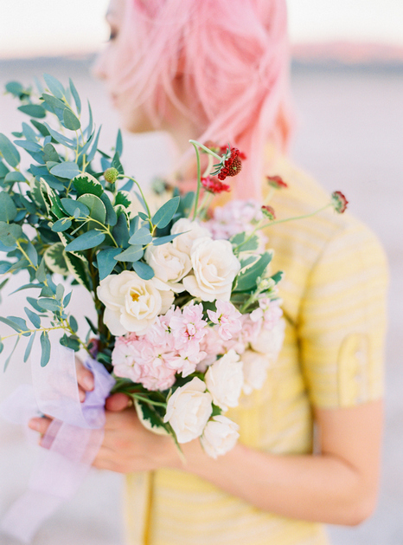
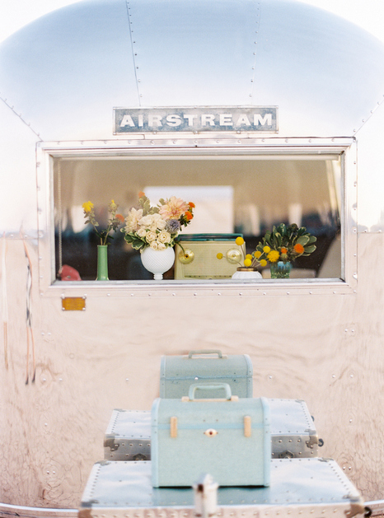
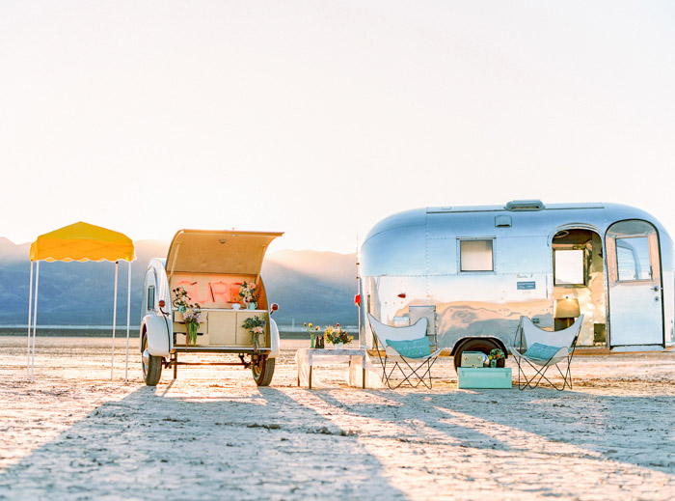
Pop Up Weddings

Slide 42
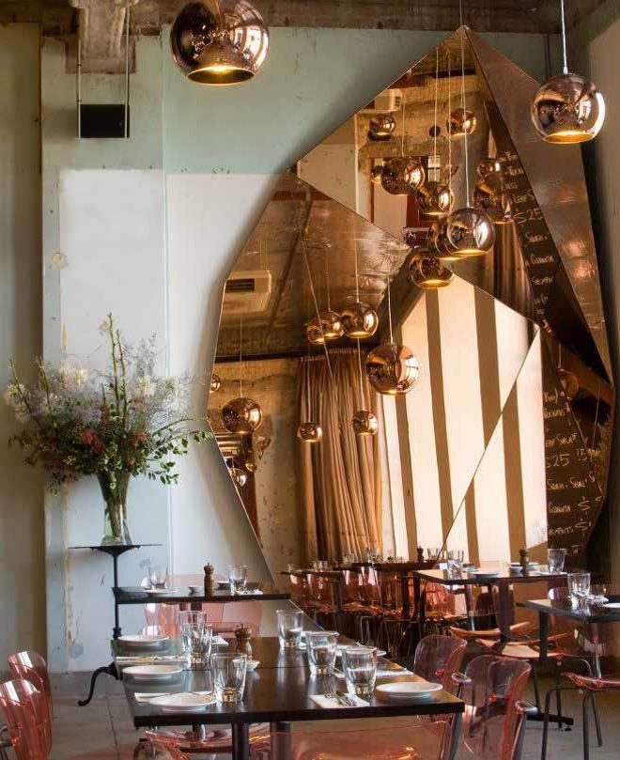
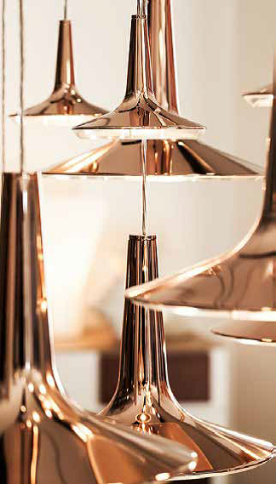

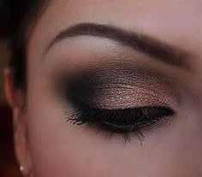
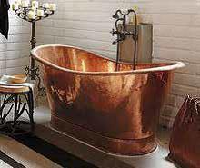
Mirrored Copper

Slide 43
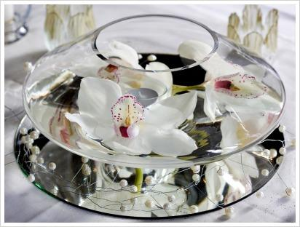
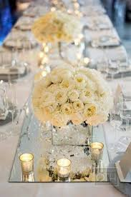
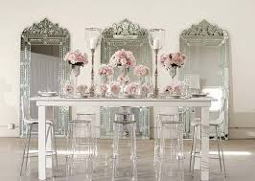
Mirrors

Slide 44





Copper Cutouts

Slide 45






Charming Details

Slide 46






Red Lace

Slide 47




Hand Lettering

Slide 48




Blushing Ombre

Slide 49





Black Lace

Slide 50





Pink Champagne

Slide 51




Crystal Frost

Slide 52


